Slide 1
Employee Data Analysis using Excel
STUDENT NAME:S.DAYANA
REGISTER NO:312214562/C36091778485C74BB164F873A8B015D0
DEPARTMENT:DEPARTMENT OF COMMERCE
COLLEGE:ST.THOMAS COLLEGE OF ARTS AND SCIENC E

Slide 2
PROJECT TITLE
VISUALIZING EMPLOYEE ATTENDANCE TREAD WITH EXCEL CHART

Slide 3


AGENDA
Problem Statement
Project Overview
End Users
Our Solution and Proposition
Dataset Description
Modelling Approach
Results and Discussion
Conclusion
3/21/2024 Annual Review

Slide 4

PROBLEM STATEMENT
In our organization, employee attendance is critical to maintaining productivity and ensuring smooth operations. However, the current approach to monitoring and analyzing attendance is primarily manual and lacks a structured, visual method for identifying trends and patterns.

Slide 5

PROJECT OVERVIEW
1)To automate the analysis of employee attendance data.2)To create easy-to-understand Excel charts that visualize trends in attendance over time.3)To provide management with actionable insights that support decision-making related to employee scheduling, leave policies, and interventions for improving attendance.
.

Slide 6

WHO ARE THE END USERS?
1Human Resources (HR) and Managers2Team Leaders and Managers3Senior Management and Executives4Operations and Planning Teams5Finance Department6Employee Relations or Engagement Teams7Employees

Slide 7

OUR SOLUTION AND ITS VALUE PROPOSITION
Our solution offers a comprehensive approach to visualizing employee attendance trends using Excel charts. By integrating data analysis with clear graphical representations, we make it easier for organizations to monitor attendance patterns and identify trends over time.

Slide 8
Dataset Description
Employee= KAGGLE
26-Features
9-Features
Emp Id- Number
Name Text
Emp- Type
Current Employee Rating- Number
Gender- Male Female
Employee Rating -Number

Slide 9

THE "WOW" IN OUR SOLUTION
=IFS(Z8>=5,”VERY
HIGH”,Z8>=4,”HIGH”,Z8>3,”MED”,TRUE,”LOW”)
3/21/2024 Annual Review
9

Slide 10
MODELLING
Dynamic Charts: Use line charts or area charts to show trends over time.
These can help you easily identify patterns and fluctuations in attendance.
Conditional Formatting: Highlight specific data points or ranges using color scales or data bars.
For instance, you might use a gradient to show attendance levels, with high attendance in green and low in red.
10

Slide 11
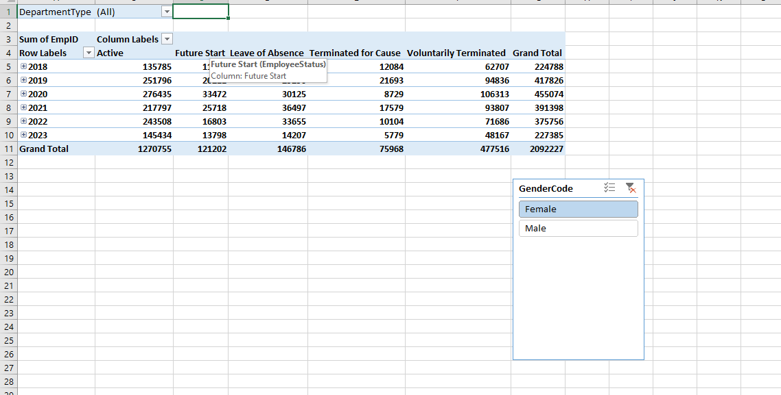
RESULTS

Slide 12
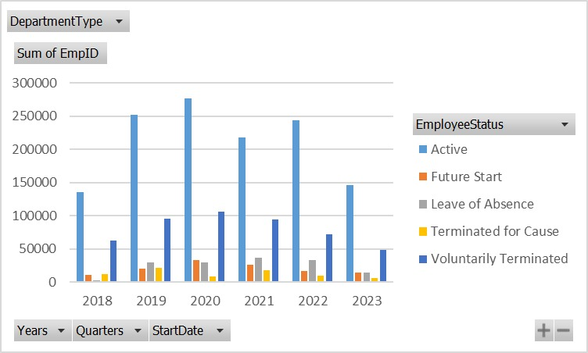
RESULTS
12

Slide 13
conclusion
Improve employee retention and engagement
Optimize training and development programs
Enhance diversity, equity, and inclusion initiatives
Inform data-driven decisions on compensation and benefits

